Slide 1
Data Structures
ICT-1211
Information and Communication Technology
Lecture-26
Date: //2024

Slide 2
TREES

Slide 3
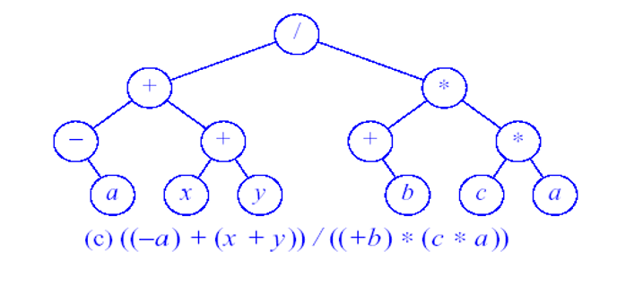
Binary Tree: Expression

Slide 4
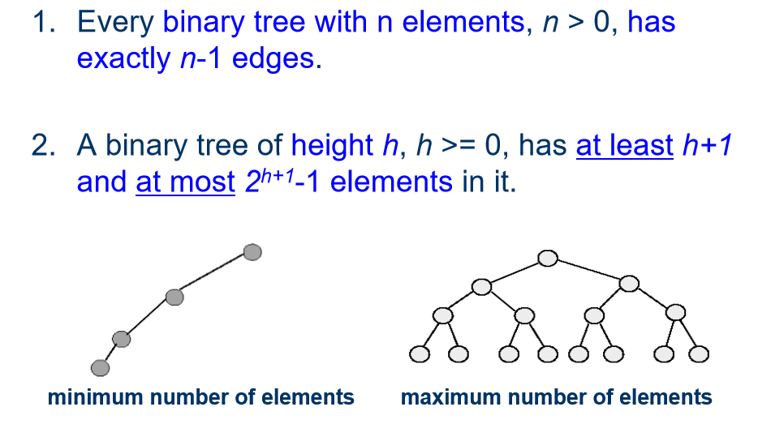
Binary Tree: Properties

Slide 5
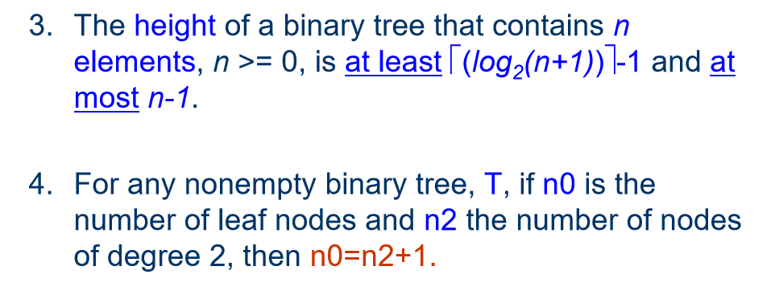
Binary Tree: Properties

Slide 6
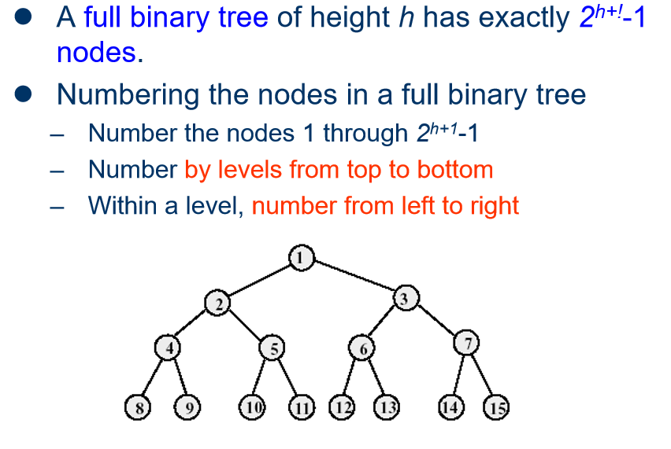
Full Binary Tree

Slide 7
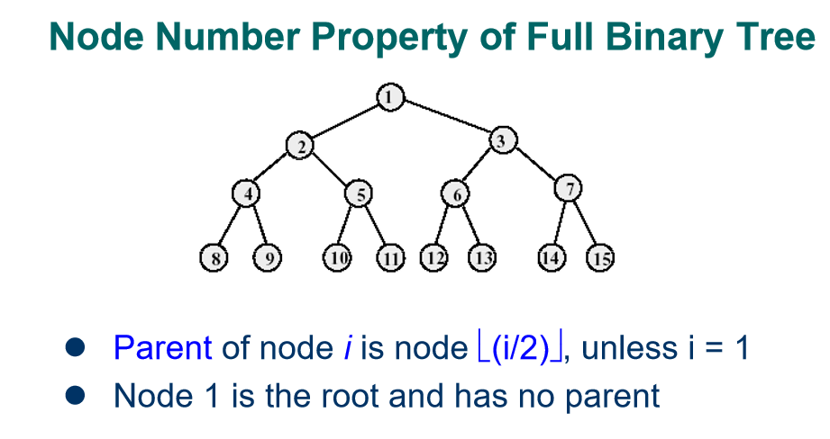
Full Binary Tree

Slide 8
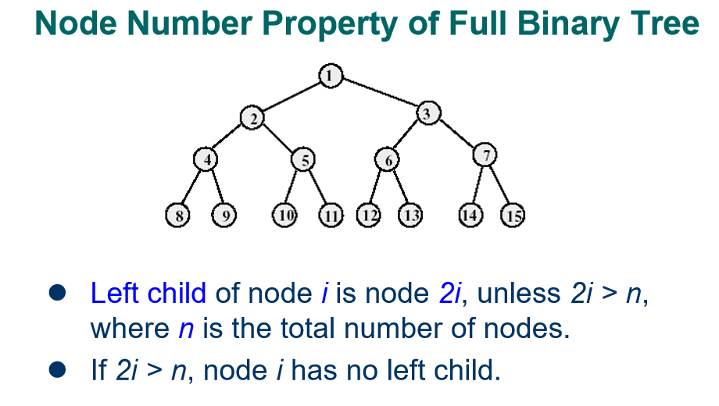
Full Binary Tree

Slide 9
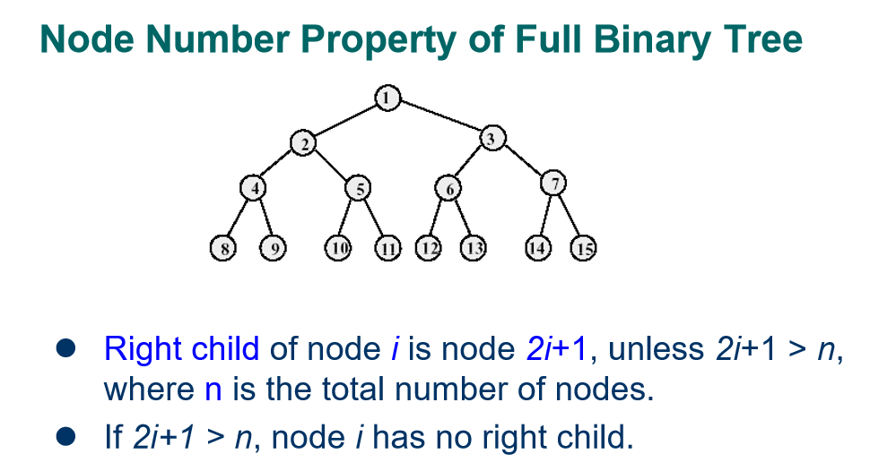
Full Binary Tree

Slide 10
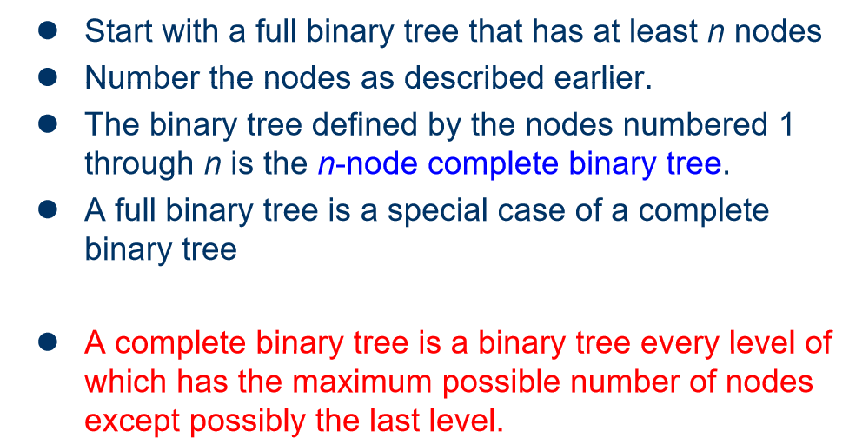
Complete Binary Tree

Slide 11
Complete Binary Tree
The tree T is said to be complete if all it’s levels, except possibly the last, have the maximum number of possible nodes, and if all the nodes at the last level appear as far left as possible.
1
2 3
4 5 6 7
8 9 10 11 12 13 14 15
16 17 18 19 20 21 22 23 24 25 26

Slide 12
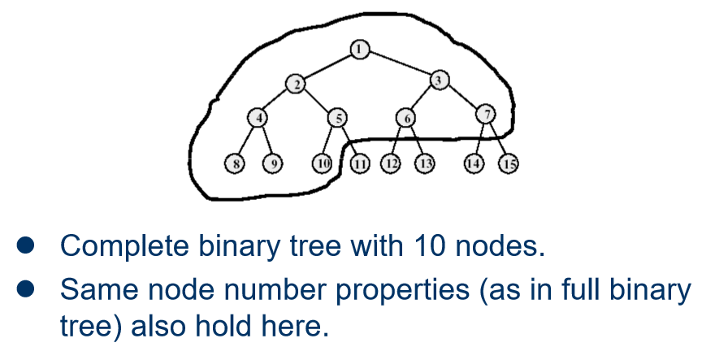
Example of Complete Binary Tree

Slide 13
Extended Binary Trees: 2-Trees
A binary tree T is said to be 2-tree or an extended binary tree if each node N has either 0 or 2 children. In such case, the nodes with 2 children are called internal nodes, and the nodes with 0 children are called external nodes.
Notes:
Circles-

Slide 14
Extended Binary Trees: 2-Trees
A binary tree T is said to be 2-tree or an extended binary tree if each node N has either 0 or 2 children. In such case, the nodes with 2 children are called internal nodes, and the nodes with 0 children are called external nodes.
Notes:
Circles-

Slide 15
Thank you……

